Slide 1
Predicting customer buying behaviour
ANALYSIS OF HOW AIRLINE AND CUSTOMER VARIABLES CAN AFFECT THE COMPLETION OF BOOKING BY CUSTOMERS
FORTUNE NWANKWO (THE WEIRD ANALYST)

Slide 2
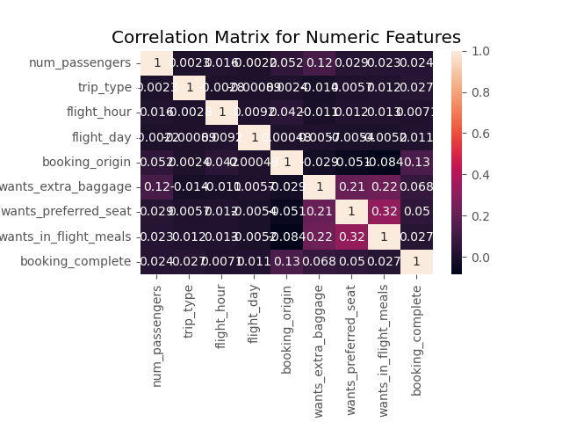
RESULTS
Sales Channel, Trip Type, Flight Day, Route and Booking Origin were removed from the dataset because they negatively correlated with Booking Complete and affected our model accuracy negatively. Our model accuracy jumped from 60% to 81% after the removal of those columns.
Booking origin is a determinant factor as to whether a booking will be complete or not. Booking origin correlation to Booking Complete is at 13% (The highest).
Passengers wanting extra baggage also affect whether a booking will be complete or not with a correlation of 6.8%.

